Slide 1


Welcome
@t4gbristol #tech4good

Slide 2
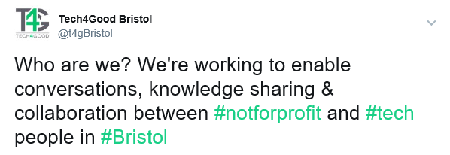
What is "Tech4Good Bristol"?
Non-funded (sponsors cover meetup.com and other costs)
Run by volunteers
Community group
Focus on needs of not-for-profit sector

Slide 3
Mission (should we choose to accept it)
Provide a friendly, welcoming space for people who are interested in using digital technologies for the social good Previous tech knowledge/skill required = ZERO!
Run talks and workshops to improve digital and data skills for those who work/volunteer at not-for-profit organisations
Signpost to other local activities that are working towards similar goals
@t4gbristol #tech4good
Notes:
Voluntary. Not funded. Community group. Suggestions welcomed, demands (not so much)

Slide 4
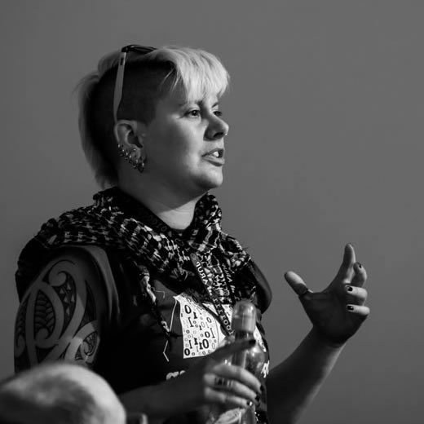
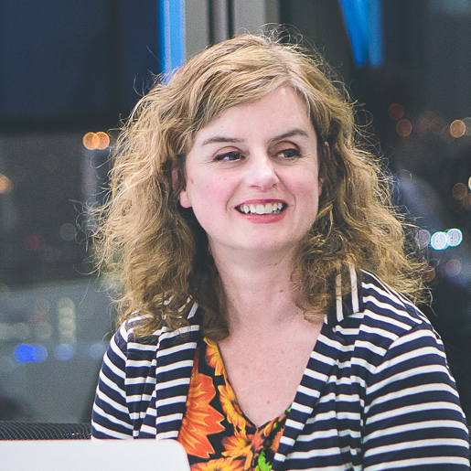
Organising Team
Jen Williams
Software Developer
Networked Planet
Ed Howarth
Development Worker
Voscur & Bath SDR
Helen Woodcock
Business Development
KETL
@t4gbristol #tech4good
Notes:
Voluntary. Not funded. Community group. Suggestions welcomed, demands (not so much)

Slide 5
The Plan
Quarterly Meetups for 2017
Thurs March 23rd
Thurs June 15th
September - date TBA
December - date TBA
Each Meetup Will Include:
Interesting content
"Community Shout Outs"
Time to talk to others:
Knowledge Sharing
Networking
General chat
Ideas for future sessions
@t4gbristol #tech4good
Notes:
Voluntary. Not funded. Community group. Suggestions welcomed, demands (not so much)

Slide 6





Sponsors
NetSquared
NetSquared gathers together nonprofits and activists, tech leaders and funders, and everyone who's interested in using technology for social change.
TechSoup
Donated technology for nonprofits.
Technology Trust
TechSoup's UK partner - We can help your charity, social enterprise or nonprofit access the donated software, email marketing and other digital services that are right for you
Venue - Bristol Energy
Bristol Energy is a gas and electricity company that offers fair and transparent electricity and gas tariffs for domestic and business customers across Bristol, the South West and nationwide.
Food and Drink - KETL
"We love data. And we love helping organisations make the most of it, covering everything from data quality, integration and migration to warehousing, data analysis and visualisation."
@t4gbristol #tech4good

Slide 7
Housekeeping
@t4gbristol #tech4good

Slide 8
Softwire & Voscur
Creating Success: Positive partnership tips for Pro Bono projects!
@t4gbristol #tech4good

Slide 9
Skills Platform
5 lessons for non-profits from the social media toolkit
@t4gbristol #tech4good

Slide 10
Bristol Refugee Hack
Tech for refugees: the Bristol Refugee Hackday
@t4gbristol #tech4good

Slide 11
360Giving
Opening up grant-making - 360Giving's GrantNav
@t4gbristol #tech4good

Slide 12
Community Shout Outs
Shout outs are a way of letting the meetup group know about events, projects, other meetup groups, tools, and anything you think will be of interest.
Form orderly queue
60 seconds max (shorter if possible!)
Write the details on a sticky note
A title
Your name
Contact details: twitter / email / website
If you prefer not to speak in front of a group - chat to an organiser and they will do the shout out for you
@t4gbristol #tech4good #communityshoutouts

Slide 13
Chat time!
This meetup finishes at 8pm Please help us keep the room tidy
@t4gbristol #tech4good

